Slide 1
Introduction to MA and the
unemployment insurance
system
05-01-2017

Slide 2
Today’s agenda
Group session – about 55 minutes
What sort of seminars, workshops or individual guidance can MA offer you?
What rules must you follow? What does it mean to be ‘available for work’?
What are the three different organisations you must deal with as an unemployed?
A-kasse
Jobcenter/Secondary operator (or ‘Anden Aktør’)
What is ‘activation’ and how can you use it to your benefit?
Personal interview
Assessment of your cv at ‘Jobnet’
Finalization of ‘Min Plan’ and ‘Krav til jobsøgning’
Introduction to MA and unemployment insurance

Slide 3
What can MA offer you besides benefits?
As a member of MA, you have free access to all we have to offer, such as:
Workshops, larger events and membership networks
Individual guidance
Open feedback (‘Åben feedback’) every Wednesday – either between 11-12.30 pm or 1-3 pm
Web-Direct
Access to our facilities Monday-Thursday 8.30 am to 9 pm and Friday between 8.30 am and 3 pm
Members’ advocate / (‘Medlemmets advokat’)
Introduction to MA and unemployment insurance

Slide 4
‘Availability’ - 1
‘Availability’ is the central principle!
The most important thing to remember:
To receive benefits, you must always be available to assume work!
If you fail an availability assessment at MA, you could lose your benefits.
Introduction to MA and unemployment insurance

Slide 5
‘Availability’ - 2
To remain ‘available’, you must:
Apply to multiple, full-time jobs every week, even during ‘activation’ and even if you are working part time while receiving ‘dagpenge’ on the side
At least one of these must be for a solicited, full-time job in Denmark
If need be, go beyond your field of expertise if you have trouble finding employment. Consider applying for unsolicited positions or through network
We use your job log at ma-kasse.dk to assess your availability – keep it updated! You must update every week, either at Jobnet.dk or ma-kasse.dk
You must upload a minimum of 1 application each month to Jobnet.dk or the self-service section at ma-kasse.dk
Main focus must be on the Danish labour market.
Introduction to MA and unemployment insurance

Slide 6
Three types of organisations
A-kasse
Jobcenter
‘Anden aktør’
Non-profit, private insurance company
Controlled by its’ board of members
Pays out unemployment benefits (‘dagpenge’)
Performs ‘Availability assessments’
Can NOT grant ‘activation’
Government agency
Can grant ‘activation’ (e.g. courses, temp-jobs etc.)
Does not pay out benefits
Can NOT perform ‘availability assessments’
Private, for-profit company, handling outsourced tasks for the Jobcenter
Can grant ‘activation’ (e.g. courses, temp-jobs etc.)
Does not pay out benefits
Can NOT perform ‘availability assessments’
Introduction to MA and unemployment insurance

Slide 7
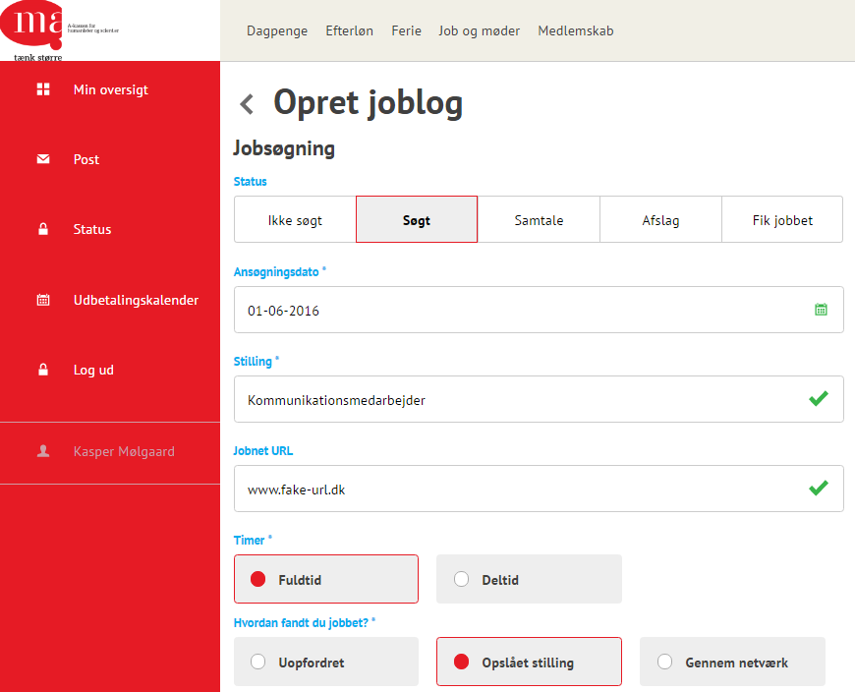
Job log
Set your registration to ‘Søgt’. Otherwise it doesn’t count!
If you wish, you can also set it to ‘samtale’, ‘afslag’ etc.
Remember to have at least one weekly registration as ‘solicited + fulltime’
You can update your job log both at MA or Jobnet – they are auto- matically synchronized.
Introduction to MA and unemployment insurance

Slide 8
Who does what?
A-kasse |  | Jobcenter | ‘Activation’
Intro-meeting Availability assessment Availability assessment | 1st month 2nd month 3rd month 4th month 5th month 6th month | Interview (joint interview) Interview Interview Interview Interview Interview (joint interview) | Activation (below age 30 / above age 50) Activation (between ages 30-49)
Assessments as needed | 7+ months | Interviews every 3rd month
Introduction to MA and unemployment insurance

Slide 9
‘Activation’
You have the right (or the duty!) to be ‘activated’ at least once during your unemployment. Be pro-active!
Company internship for a duration of 4 to 8 weeks
Subsidised employment – public sector (4 months duration– available after 6 months unemployment) (‘Løntilskudsjob’)
Subsidised employment – private sector (6 months duration – available after 6 months unemployment) (‘Løntilskudsjob’)
Individual guidance, workshops, courses etc. (Very rare)
Introduction to MA and unemployment insurance

Slide 10
‘Dagpenge’ = Unemployment benefits
2 full years (104 weeks) of benefits
You can choose to skip a week – your remaining total will still be there when you return
However, unused weeks expire after 3 years
Read more in “Your Guide to the Unemployment System” at ma-kasse.dk.
104
weeks
Dagpenge
1
Start date:
January 1st 2017
To be used before: 31st of December 2019
2
3
4
5
6
7
8
9
10
Introduction to MA and unemployment insurance

Slide 11
‘Supplementary’ benefits
30
weeks
You work part-time – MA supplements your earnings with ‘dagpenge’
A maximum of 30 of the total 104 weeks (only applies if you’re already eligible for ‘dagpenge’)
Example: Hours of work: 20 hours/week MA tops up: 17 hours/week 37 hours
Supplementary
benefits
1
Start date:
January 1st 2017
Conditioned on your eligiblity for ‘dagpenge’
2
3
4
5
6
Please note:
The 30 weeks are NOT in addition, but rather part of the full 104 weeks
104
7
8
74
9
30
10
30
Introduction to MA and unemployment insurance

Slide 12
Being self-employed and on ‘dagpenge’
78
weeks
You own and operate a business – MA supplements your income with ‘dagpenge’.
How it works:
Apply using the form AR259A before you start
Important: Don’t start up until it’s been approved!
Conditions:
You must not be bound by any company opening hours during weekdays between 8 am and 5 pm
Learn more at ma-kasse.dk. You can also sign up for our quarterly workshop ”Selvstændig bibeskæftigelse (only held in Danish).
Self-employment and ‘dagpenge’
1
Start date:
January 1st 2017
Conditioned on your eligiblity for ‘dagpenge’
2
3
4
5
6
7
8
9
10
Introduction to MA and unemployment insurance

Slide 13
Looking for jobs within the EEA
You can receive unemployment benefits for 3 months while lookin for work within the Euro zone. Conditions:
Unemployed for at least 4 weeks before departure
You must follow the local rules of the country in question
Apply with the form PDU2
Learn more by reading ”jobsøgning i udlandet” at ma-kasse.dk. Pertains to all EU countries, plus a few others.
Introduction to MA and unemployment insurance

Slide 14
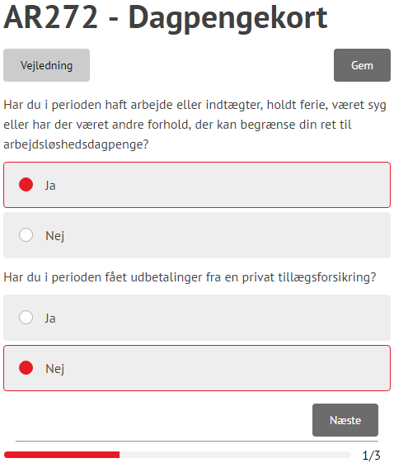
How to fill in your ‘dagpengekort’
To actually receive any money, you need to submit the form ‘dagpengekort’ once a month.
Choose the ‘dagpenge’ tab
Choose ”Indsend dagpengekort”
Select time period
Note: If the ‘dagpengekort’ is missing, your eligiblity for ‘dagpenge’ may not be finalized. Have you submitted a ‘ledighedserklæring’?
Introduction to MA and unemployment insurance

Slide 15
Practical information
In case of illness:
Report your illness on the first day at Jobnet
MA receives automatic notification by Jobnet
Report back to Jobnet as soon as you recover
Vacation:
Vacation must be registered with Jobnet no later than 14 days before it starts
If there is less than 14 days untill the start date of your vacation, contact your Jobcenter or ‘anden aktør’ / secondary operator. However, there is a chance it will no longer approved!
Introduction to MA and unemployment insurance

Slide 16
Other avenues for your job search
Akademikerbasen.dk
Innovationsfonden.dk
Onlinekurser.dk
Volunteering at NGO’s, non-profits etc.
Introduction to MA and unemployment insurance

Slide 17
A few final words…
Still registered as a ‘student’ member? Fill out form AK 044 at the self-service section at MA-kasse.dk
Always check your mail from your Jobcenter via Jobnet.dk
Remember to book your own meetings / interviews with your Jobcenter before the deadline! If you forget, you will be automatically unregistered at Jobnet and lose benefits. This also applies to ‘rådighedssamtaler’ at you’re a-kasse
Update your job log at least once every week!
Fill out your ‘dagpengekort’ every month at ma-kasse.dk.
Introduction to MA and unemployment insurance

Slide 18
And now for your personal interview..
Make yourself comfortable in the lounge area
Enjoy some coffee, fruit and whatever else you might fancy
Mingle!
(There may be a slight wait before your interview).
Cv-møde i MA

