Slide 1
Welcome to MA
07-08-2018

Slide 2
Today’s meeting
Joint information meeting (appr. 60 min.)
Magistrenes a-kasse/MA Odense
Availability and job search
MA Selvbetjening (Self service module) and joblog
Course of meetings – MA and Jobcenter
Possibilities as job searcher and membership services
Summing up
Individual talk
Approving CV on jobnet.dk
Finishing Krav til jobsøgning and Min plan
Velkomstmøde i MA

Slide 3
Magistrenes A-kasse
Odense |  | København
Mandatory meetings Availability check Sparring and guidance Workshops |  | Unemployment benefit Vacation Early retirement (Efterløn ) Self employment EØS/EEA Membership
Velkomstmøde i MA

Slide 4
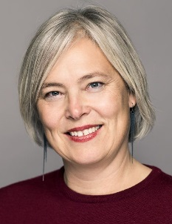
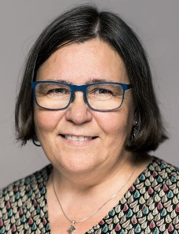
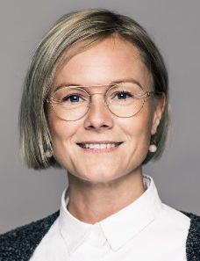
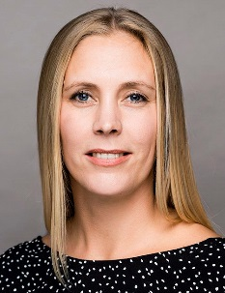
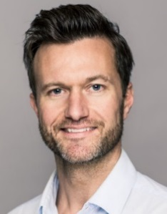
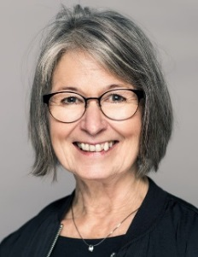
MA Odense
Open Feedback Wednesdays 1-3 pm
Access to facilities
Transport allowance + 25 km
Mette Borch Ovdal
Karriererådgiver
Bitten Eskesen
Karriererådgiver
Line Svindt
Karriererådgiver
Sidsel Paulsen
Karriererådgiver
Rasmus B. Laursen
Karriererådgiver
Inger Beck Ginnerup
Forsikringsrådgiver
Velkomstmøde i MA

Slide 5
MA Self Service - Selvbetjening
On MA Selvbetjening – self service module you:
Receive all mail from us.
Fill in and mail your claims card ‘dagpengekort’ - (six workdays before the end of the month).
Register your job search activities on the joblog (data is continiously exchanged with jobnet.dk)
Find varius forms you may need
Velkomstmøde i MA

Slide 6
Practical information
Illness
Register that you are ill on Jobnet
MA is automatically notified by Jobnet
Register that you are well again on Jobnet
Holiday
Register your holiday at least 14 dage before start on Jobnet
If less thatn 14 days – contact the jobcenter personally or by phone
Velkomstmøde i MA

Slide 7
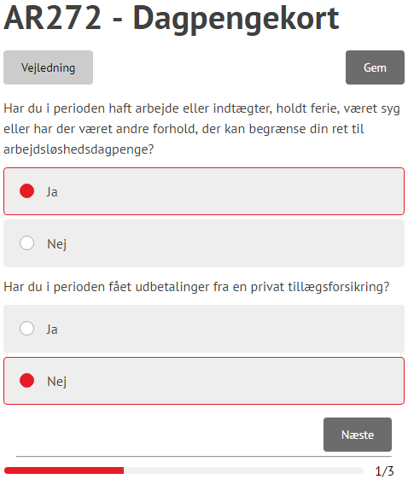
Claims Card
Press the tap ”dagpenge”
Chose ”Indsend dagpengekort”
Chose the month
The claims card must be sent to us within one month and 10 days, f. ex. The August card skal indsendes senest 10. October
NB: If your claims card is not available, it is probably because we have not yet processed your ledighedserklæring.
Velkomstmøde i MA

Slide 8
To be available
Apply for several jobs every week in Danmark
One of them must be advertized and full time
Apply realistically
Apply in the way, that is usual within that field
Widen your scope – professionally and geographically
If the job center tells you to apply for a specific job, you must do it
Register your job search every week in the joblog on MA Selvbetjening orJobnet.dk
Upload at least one application/cv every month in the joblog
Tjeck your ”jobforslag” on Jobnet every 7th day
Keep the plans in ”Min Plan” samt ”Krav til jobsøgning”
Stay in Denmark and be registered at jobnet.dk
NB: MA assesses your availability – not the Job Center
Velkomstmøde i MA

Slide 9
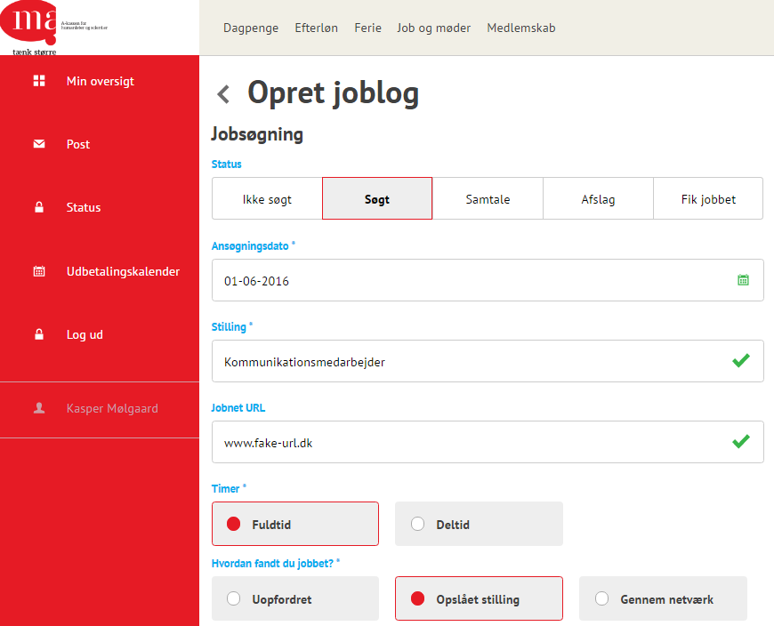
Joblog
If the job is registered as ”Ikke søgt” in the joblog, it doesn’t count
You are welcome to register the further process as ‘samtale’, ‘afslag’ etc.
Register at least one advertized, full time position every week.
It is up to you, if you use the joblog from MA Selvbetjening or Jobnet.
Velkomstmøde i MA

Slide 10
Course of meetings – MA and Job Center
A-kasse |  | Jobcenter | Activation
Welcome meeting Availability check Availability check | 1. month 2. month 3. month 4. month 5. month 6. Month | Meeting (joint meeting) Meeting Meeting Meeting Meeting Meeting (joint meeting) | activation (under 30 or over 50 years) Activation (between 30-49 years)
Husk |  | Husk | Husk
Joblog – every week! |  | Check jobforslag – every week! meetings | My Plan
Velkomstmøde i MA

Slide 11
Activation
You are obligated to participate in activation at least once during your unemployment – be pro-active.
Job search courses etc.
Internships for 4 or 8 weeks
Subsidized job in public sector (max. 4 months – after 6 months’ uemployment)
Subsidized job in private sector (max. 6 months – after 6 months’ uemployment)
Velkomstmøde i MA

Slide 12
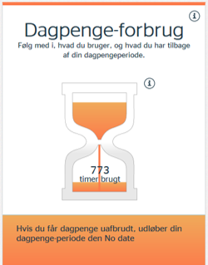
Unemployment benefit – how long?
Unemployment benefit for 3.848 hours = 2 years
Read more in the Pixi book
Velkomstmøde i MA

Slide 13
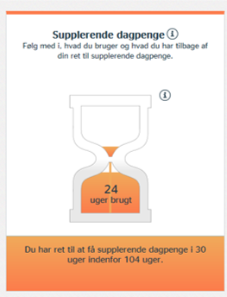
Supplementary benefit – how long?
You work part time – MA supplement with benefit
Example: Working hours: 20 hours/month MA supplement:140,33 hours/month
Max. 30 weeks out of 104 (for as long as your have right to unemployment benefit)
Velkomstmøde i MA

Slide 14
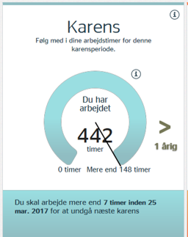
Karens?
Unemployment benefit for 4 months = is reduced by 7 hours
Unless you have worked at least 148 hours
Velkomstmøde i MA

Slide 15
Options as job seeker
Courses (AK020)
Under 20 hours/week
Not an education which entitles to SU
Onlinekurser.dk
Voluntary work (AK048)
Akademikerkampagnen
Akademikerbasen.dk
Workshops and courses in MA – in Danish
Jobdatabases, jobagents and LinkedIn
Work in Denmark
Velkomstmøde i MA

