Slide 1
Welcome to MA
18-01-2019

Slide 2
Today’s meeting
Joint information meeting (appr. 60 min.)
Magistrenes a-kasse/MA Odense
Availability and job search
MA Selvbetjening (Self service module) and joblog
Course of meetings – MA and Jobcenter
Possibilities as job searcher and membership services
Summing up
Individual talk
Approving CV on jobnet.dk
Finishing Krav til jobsøgning and Min plan
Velkomstmøde i MA

Slide 3
Magistrenes A-kasse
Odense |  | København
Mandatory meetings Availability check Sparring and guidance Workshops |  | Unemployment benefit Vacation Early retirement (Efterløn ) Self employment EØS/EEA Membership
Velkomstmøde i MA

Slide 4
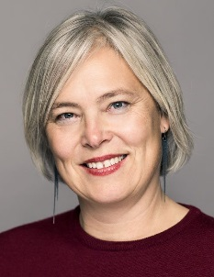
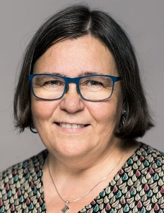
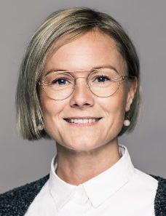
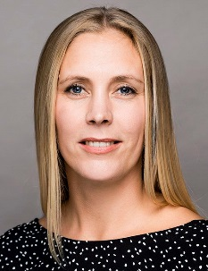
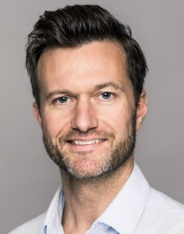
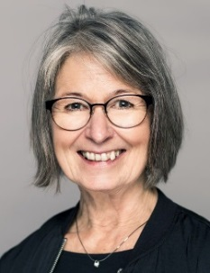
MA Odense
As a member of MA you have access to:
Workshops, meetings etc. (check our website)
Personal guidance and advice
Open Feedback Wednesdays 1-3 pm
Business Insight
Access to facilities
Transport allowance + 25 km
Mette Borch Ovdal
Karriererådgiver
Bitten Eskesen
Karriererådgiver
Line Svindt
Karriererådgiver
Sidsel Paulsen
Karriererådgiver
Rasmus B. Laursen
Karriererådgiver
Inger Beck Ginnerup
Forsikringsrådgiver
Velkomstmøde i MA

Slide 5
MA Self Service - Selvbetjening
On MA Selvbetjening – self service module you:
Receive all mail from us.
Fill in and mail your claims card ‘dagpengekort’ - (six workdays before the end of every month).
Register your job search activities on the joblog (data is continiously exchanged with jobnet.dk)
Find varius forms you may need
Velkomstmøde i MA

Slide 6
Practical information
Illness
Register that you are ill on Jobnet
MA is automatically notified by Jobnet
Register that you are well again on Jobnet
Holiday
Register your holiday at least 14 days before start on Jobnet
If less thatn 14 days – contact the jobcenter personally or by phone
Velkomstmøde i MA

Slide 7
To be available
Apply for several jobs every week in Danmark
One of them must be advertized and full time
Apply realistically
Apply in the way, that is usual within that field
Widen your scope – professionally and geographically
If the job center tells you to apply for a specific job, you must do it
Register your job search every week in the joblog on MA Selvbetjening or Jobnet.dk
Upload at least one application/cv every month in the joblog
check your ”jobforslag” on Jobnet every 7th day
Keep the plans in ”Min Plan” samt ”Krav til jobsøgning”
Stay in Denmark and be registered at jobnet.dk
NB: MA assesses your availability – not the Job Center
Velkomstmøde i MA

Slide 8
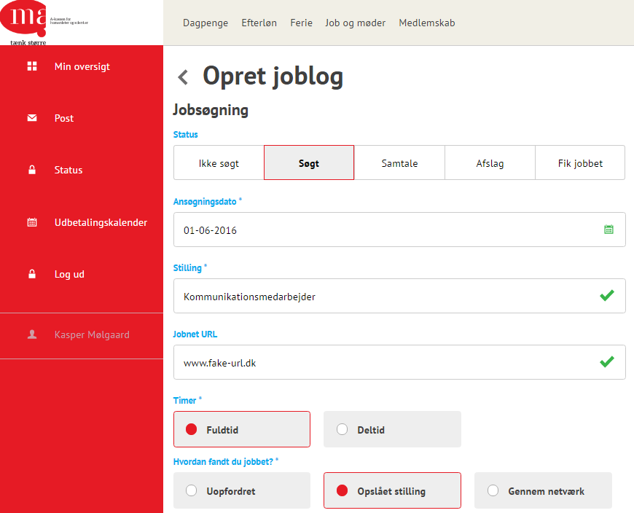
Joblog
If the job is registered as ”Ikke søgt” in the joblog, it doesn’t count
You are welcome to register the further process as ‘samtale’, ‘afslag’ etc.
Register at least one advertized, full time position every week.
It is up to you, if you use the joblog from MA Selvbetjening or Jobnet.
Velkomstmøde i MA

Slide 9
Course of meetings – MA and Job Center
A-kasse |  | Jobcenter | Activation
Welcome meeting Availability check Availability check | 1. month 2. month 3. month 4. month 5. month 6. Month | Meeting (joint meeting) Meeting Meeting Meeting Meeting Meeting (joint meeting) | activation (under 30 or over 50 years of age) Activation (between 30-49 years of age)
Husk |  | Husk | Husk
Joblog – every week! |  | Check jobforslag – every week! meetings | My Plan
Velkomstmøde i MA

Slide 10
Activation
You are obligated to participate in activation at least once during your unemployment – be pro-active.
Job search courses etc.
Internships for 4 or 8 weeks
Subsidized job in public sector (max. 4 months – after 6 months of uemployment)
Subsidized job in private sector (max. 6 months – after 6 months of uemployment)
Velkomstmøde i MA

Slide 11
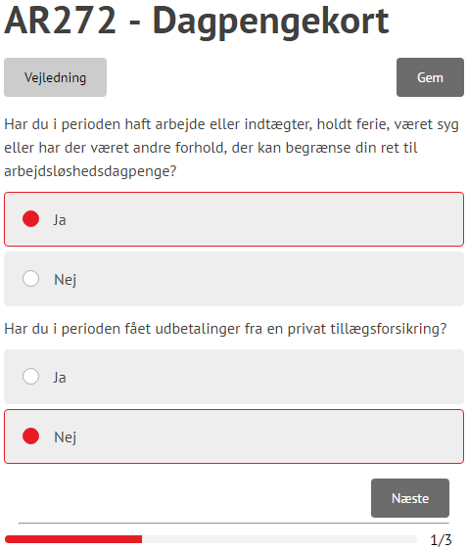
Claims Card
Press the tap ”dagpenge”
Chose ”Indsend dagpengekort”
Chose the month
The claims card must be sent to us within one month and 10 days, f. ex. The August card skal indsendes senest 10. October
NB: If your claims card is not available, it is probably because we have not yet processed your ledighedserklæring.
Velkomstmøde i MA

Slide 12
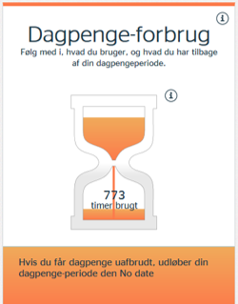
Unemployment benefit – how long?
Unemployment benefit for 3.848 hours = 2 years
New period of unemployment benefit = 1924 hours work
Read more in the Pixi book
Velkomstmøde i MA

Slide 13
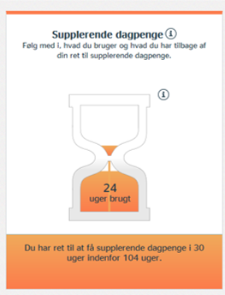
Supplementary benefit 1
You work part time – MA supplement with benefit
Example: Working hours: 100 hours/month MA supplement:60,33 hours/month
The maximum period of supplementary benefit is 30 weeks.
Remember: you need a ‘Frigørelsesattest’
Velkomstmøde i MA

Slide 14
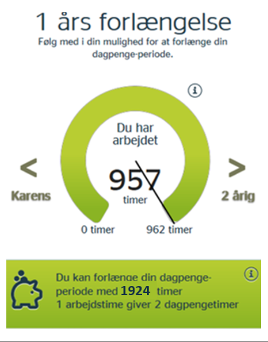
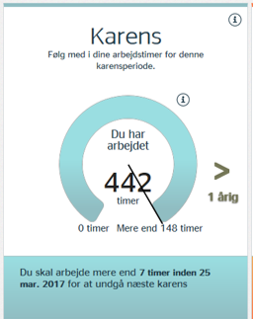
Beskæftigelseskonto – and Deduction Day
The hours you work can be used for:
Either a new period of unemployment benefit
Extension of your present unemployment period – 1 hour gives you 2 hours extension (max. of one year).
Deduction Day (Karens)
Unemployment benefit for 4 consecutive months, 7 hours will be deducted from you unemployment benefit, unless you have worked at least 148 hours
Velkomstmøde i MA

Slide 15
Supplementary benefit 2
Freelance work
You get a fixed fee or remuneration for a job – MA supplements your benefit. Write the amount of your claims card. The fee is calculated into hours from a hourly rate, decided by law, of 241,73 kr. (2019-rate)
Example
You have received a fee of 5.000 kr.
This is calculated: 5.000/ 241,73 = 20,68 hours
MA supplements up to 160,33 – 20,68 = 139,65 hours for this month.
The maximum period of supplementary benefit is 30 weeks.
Velkomstmøde i MA

Slide 16
Supplementary benefit 3
Self employed – as a sideline
You have your own side business – MA supplements with benefit Note the yours you work in you own business on the claims card.
Be aware that:
You are obligated to inform MA about the activities in your business (AK320)
You must always be prepared to take full time work with a day’s notice, which means that you must not be bound my contract on a job in your business.
All weeks, you have a side business, you will deduct from your 30 weeks of supplementary benefit – even if there are weeks, where you don’t have any work in the business.
The maximum period of supplementary benefit is 30 weeks.
Velkomstmøde i MA

Slide 17
Options as job seeker
Courses (AK020)
Under 20 hours/week
Not an education which entitles to SU
Onlinekurser.dk
Voluntary work (AK048)
Akademikerkampagnen
Akademikerbasen.dk
Workshops and courses in MA – in Danish
Jobdatabases, jobagents and LinkedIn
Work in Denmark
Follow MA on LinkedIn and Facebook
Velkomstmøde i MA

