Slide 1
Introduction to MA and the
unemployment insurance
system
07-08-2019

Slide 2
Today’s agenda
Group session – about 55 minutes
What sort of seminars, workshops or individual guidance can MA offer you?
What rules must you follow? What does it mean to be ‘available for work’?
What are the three different organisations you must deal with as an unemployed?
A-kasse
Jobcenter/Secondary operator (or ‘Anden Aktør’)
What is ‘activation’ and how can you use it to your benefit?
Personal interview
Assessment of your cv at ‘Jobnet’
Finalization of ‘Min Plan’ and ‘Krav til jobsøgning’
Introduction to MA and unemployment insurance

Slide 3
What can MA offer you besides benefits?
Workshops, larger events and membership networks
Individual guidance
Open feedback (‘Åben feedback’) every Wednesday – either between 11-12.30 pm or 1-3 pm
Access to our facilities Monday-Thursday 8.30 am to 9 pm and Friday between 8.30 am and 3 pm
Members’ advocate / (‘Medlemmets advokat’)
Introduction to MA and unemployment insurance

Slide 4
‘Availability’ - 1
‘Availability’ is the central principle!
The most important thing to remember:
To receive benefits, you must always be available to assume work!
If you fail an availability assessment at MA, you could lose your benefits.
Introduction to MA and unemployment insurance

Slide 5
‘Availability’ - 2
To remain ‘available’, you must:
Apply to multiple, full-time jobs every week, even during ‘activation’ and even if you are working part time while receiving ‘dagpenge’ on the side
At least one of these must be for a solicited, full-time job in Denmark
If need be, go beyond your field of expertise if you have trouble finding employment. Consider applying for unsolicited positions or through network
We use your job log at ma-kasse.dk to assess your availability – keep it updated! You must update every week, either at Jobnet.dk or ma-kasse.dk
You must also upload a minimum of 1 application each month to Jobnet.dk or the self-service section at ma-kasse.dk
Main focus must be on the Danish labour market.
Introduction to MA and unemployment insurance

Slide 6
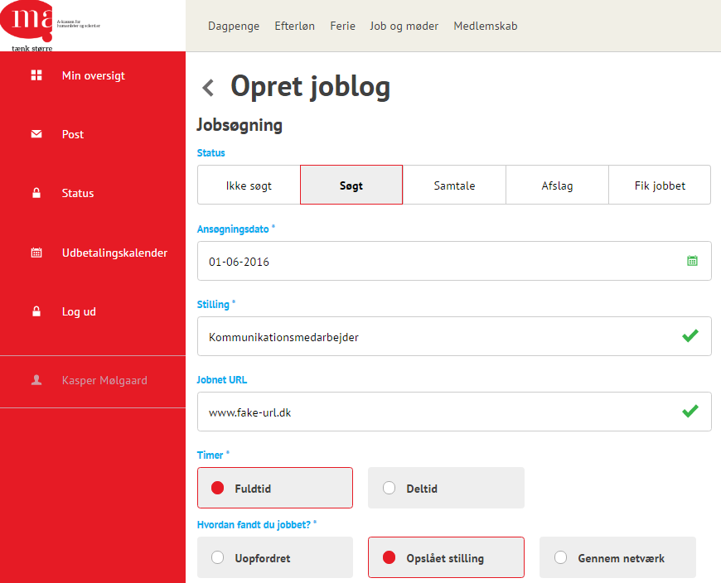
Job log
Set your registration to ‘Søgt’. Otherwise it doesn’t count!
If you wish, you can also set it to ‘samtale’, ‘afslag’ etc.
Remember to have at least one weekly registration as ‘solicited + fulltime’
You can update your job log both at MA or Jobnet – they are auto- matically synchronized.
Introduction to MA and unemployment insurance

Slide 7
Who does what?
A-kasse |  | Jobcenter | ‘Activation’
Intro-meeting Availability assessment Availability assessment | 1st month 2nd month 3rd month 4th month 5th month 6th month | Interview Interview Interview Interview Interview Interview (joint interview) | Activation (below age 30 / above age 50) Activation (between ages 30-49)
Assessments as needed | 7+ months | Interviews every 3rd month
Introduction to MA and unemployment insurance

Slide 8
‘Activation’
You have the right (or the duty!) to be ‘activated’ at least once during your unemployment. Be pro-active!
Company internship for a duration of 4 to 8 weeks
Subsidised employment – public sector (4 months duration– available after 6 months unemployment) (‘Løntilskudsjob’)
Subsidised employment – private sector (6 months duration – available after 6 months unemployment) (‘Løntilskudsjob’)
Individual guidance, workshops, courses etc. (Very rare – check the regional list with accepted courses: ‘den regionale positivliste’)
Introduction to MA and unemployment insurance

Slide 9
Supplementary benefits
If you work less than full time, MA can supplement your income with . You can ”top-up” (or supplement) your income with dagpenge if you
…work a part-time job You work a part-time job. MA supplements your income. Don’t forget a ‘notice waiver’ (‘frigørelsesattest’)
…freelance for a fee Simply write the size of the fee on your ‘dagpengekort’. The feed is converted to hours (with a set hourly rate) and the hours are then subtracted from your dagpenge
…operate your own company Write the number of spent hours on your ‘dagpengekort’. Every week you have your own company will be subtracted from the 30-week total, regardless of any activity in the company.
30
weeks total with
supplementary dagpenge
Introduction to MA and unemployment insurance

Slide 10
Looking for jobs within the EEA
You can travel to look for work within the EEA (or ‘Euro-zone’) and still receive Danish dagpenge
You can travel for up to 3 months at a time.
Learn more at ma-kasse.dk and ‘Jobsøgning i udlandet’.
Introduction to MA and unemployment insurance

Slide 11
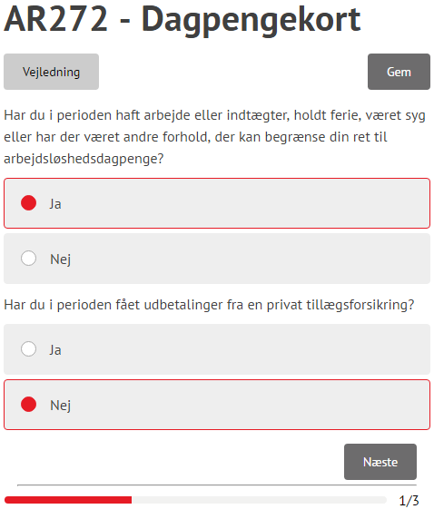
How to fill in your ‘dagpengekort’
To actually receive any money, you need to submit the form ‘dagpengekort’ once a month.
Choose the ‘dagpenge’ tab
Choose ”Indsend dagpengekort”
Select time period
Note: If the ‘dagpengekort’ is missing, your eligiblity for ‘dagpenge’ may not be finalized. Have you submitted a ‘ledighedserklæring’?
Introduction to MA and unemployment insurance

Slide 12
Practical information
In case of illness:
Report your illness on the first day at Jobnet
MA receives automatic notification by Jobnet
Report back to Jobnet as soon as you recover
Vacation:
Vacation must be registered with Jobnet no later than 14 days in advance
If there is less than 14 days untill the start date of your vacation, contact your Jobcenter.
Introduction to MA and unemployment insurance

Slide 13
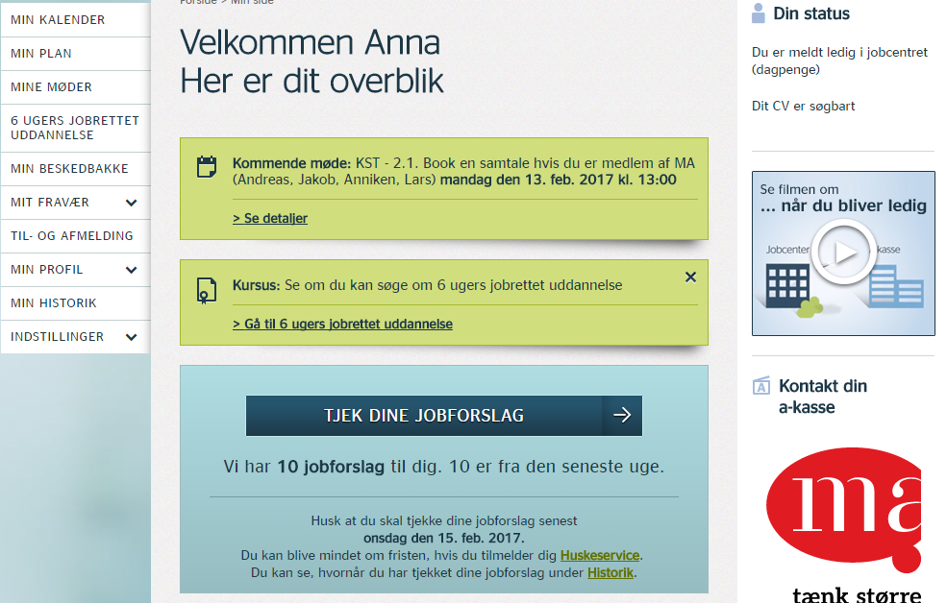
Navigating Jobnet – ”Jobforslag”
Log on and press this button every 7 days!
Introduction to MA and unemployment insurance

Slide 14
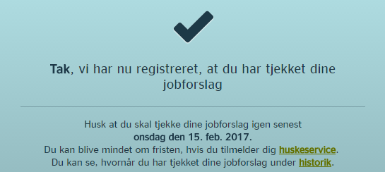
Navigating Jobnet – ”Jobforslag”
Introduction to MA and unemployment insurance

Slide 15
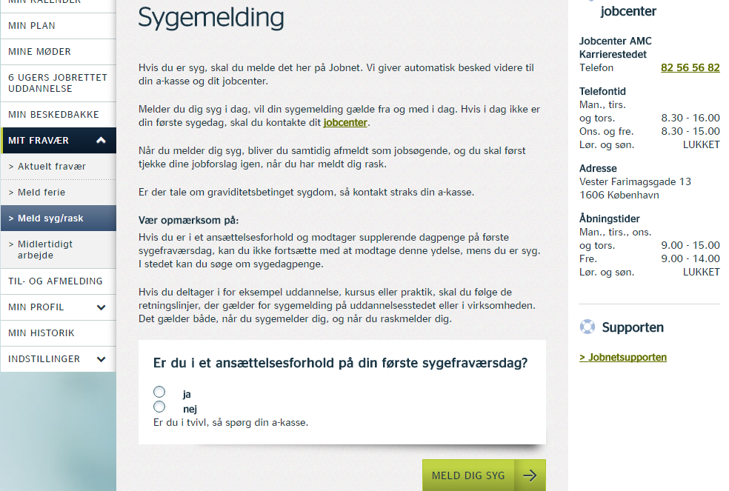
Navigating Jobnet – calling in sick
Press to save your registration!
Introduction to MA and unemployment insurance

Slide 16
Navigating Jobnet – taking a vacation
Press to save your registration!
Introduction to MA and unemployment insurance

Slide 17
Navigating Jobnet – unregistering
Press to save your registration!
Select your reason for
unregistering
Introduction to MA and unemployment insurance

Slide 18
And now for your personal interview..
Make yourself comfortable in the lounge area
Enjoy some coffee or whatever may take your fancy
Still a student member? Don’t forget to submit the form ‘AK044’ at your self-service section.
Cv-møde i MA

